Slide 1
RELATIONSHIPS

Slide 2
Relationships
Healthy relationship: Intimacy, security, respect, good communication, and a sense of being valued
Unhealthy: Fighting so much you can’t resolve problems, lack of support, contempt, criticism, and hostility
Need to know what you want/need BEFORE the relationship begins:
Genuinely knowing what you want and need in a partner and in a relationship
Selecting the right person
Developing and using skills right from the beginning
Notes:
Look for further information under Lesson 1: “What is a Healthy Relationship?”

Slide 3
Relationship Competence
The ability to function adaptively across all areas of the relationship process from figuring out what you need, to finding the right person, to building a healthy relationship, and getting out of relationships that are unhealthy.
Insight: Awareness, understanding, and learning
What type of relationship do you want?
Mutuality: Understanding that both people have needs.
Both sets of needs matter.
You can express your needs in a clear, direct fashion that increases the chances that you’ll get them met.
You’ll also be willing to meet your partners needs.
Emotional Regulation: Ability to regulate your feelings in response to things that happen in your relationship. Keep your emotions calm.
Keep things in perspective
Tolerate uncomfortable feelings
Maintain a sense of self-respect
Notes:
Look for further information under Lesson 1: “What is a Healthy Relationship?”

Slide 4
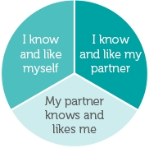
3 Conditions for a Healthy Relationship
I know and like myself
You know what your needs are
You respect those needs and are able to meet them
I know and like my partner
You are confident that your partner is the person you want
You treat your partner in a way that shows you like and respect him/her
My partner knows and likes me
You are with a partner who wants what you have to offer
Your partner treats you in a way that shows he/she likes and respects you

Slide 5
Healthy Relationships
Skills for Healthy Romantic Relationships
https://www.youtube.com/watch?v=gh5VhaicC6g
http://www.skillsforhealthyrelationships.com/conditions
Are you in a Healthy Relationship? Take quiz
https://www.loveisrespect.org/for-someone-else/is-my-relationship-healthy-quiz/

Slide 6

Healthy LGBTQ Relationships
You know your relationship is probably healthy if your partner:
Respects your chosen gender pronouns or name.
Respects your boundaries.
Gives you space to hang out with friends and family without thinking you are cheating.
Does not take your money or tell you what to buy.
Never threatens to out you to people.
Never tells you you’re not a real lesbian, gay man, trans person, or whatever you identify as because you do not have sex the way they want you to.

Slide 7

Signs of Abuse
Use these warning signs of abuse to see if your relationship is going in the wrong direction:
Checking your cell phone or email without permission
Constantly putting you down
Extreme jealousy or insecurity
Explosive temper
Isolating you from family or friends
Making false accusations
Mood swings
Physically hurting you in any way
Possessiveness
Telling you what to do or what to wear
Notes:
Look for further information under Lesson 2: “What is an Unhealthy/Abusive Relationship?”

Slide 8
Sexual Abuse
Some examples of sexual assault and abuse are:
Unwanted kissing or touching.
Unwanted rough or violent sexual activity.
Rape or attempted rape.
Keeping someone from protecting themselves from sexually transmitted infections (STIs).
Sexual contact with someone who is very drunk, drugged, unconscious, or otherwise unable to give a clear and informed “yes” or “no.”
Threatening or pressuring someone into unwanted sexual activity.
Notes:
Look for further information under Lesson 2: “What is an Unhealthy/Abusive Relationship?”

Slide 9

LGBTQ Abusive Relationships
May face obstacles when asking for help:
Shame or embarrassment.
You may be struggling with your own internalized homophobia or shame about your sexual orientation or gender identity. Your abusive partner may try to use this shame to exert power and control over you.
Fear of not being believed or taken seriously.
You may worry that if you report abuse, you will encounter stereotypes like violence between LGBTQ partners is mutual, abuse doesn’t occur in lesbian relationships, only the physically bigger partner can be abusive or LGBTQ relationships are inherently unhealthy. Your partner may exploit this fear, trying to convince you that no one will take an LGBTQ victim seriously.
Fear of retaliation, harassment, rejection, or bullying. Bullying.
If you are not yet “out” to everyone, your abusive partner may threaten to tell your secret to people. You may also fear that seeking help will make you a target of public ridicule, retaliation, harassment or bullying. Your abusive partner may exploit these fears to isolate you and keep you in the relationship.

Slide 10
Keep in Mind
Everyone has the right to decide what they do or don’t want to do sexually. Not all sexual assaults are violent “attacks.”
Most victims of sexual assault know the assailant/abuser.
Both men and women can be victims or perpetrators of sexual abuse.
Sexual abuse can occur in same-sex and opposite-sex relationships.
Sexual abuse can occur between two people who have been sexual with each other before, including people who are married or dating.
Notes:
Look for further information under Lesson 2: “What is an Unhealthy/Abusive Relationship?”

Slide 11

What to do next?
Contact someone you trust.
Report what happened to the police.
Go to an emergency room or a health clinic to receive medical assistance.
Get more tips for building a support system by visiting www.loveisrespect.org.
Notes:
Look for further information under Lesson 2: “What is an Unhealthy/Abusive Relationship?”

Slide 12

Texting and Sexting
Abuse through texting:
Texting too much/too often.
Sexting can also have legal consequences. Any nude photos or video of someone under 18 could be considered child pornography, which is always illegal. Even if whoever sent the image did so willingly, the recipient can still get in a lot of trouble.
Reading someone else’s text.
Threats over text.
Notes:
Look for further information under Lesson 2: “What is an Unhealthy/Abusive Relationship?”

Slide 13

Stalking
Some examples of what stalkers may do:
Show up at your home or school unannounced or uninvited.
Send you unwanted text messages, emails, and voicemails.
Leave unwanted items, gifts, or flowers.
Constantly call you and hang up.
Use social networking sites and technology to track you.
Spread rumors about you via the internet or word of mouth.
Make unwanted phone calls to you.
Wait at places you hang out.
Damage your property.
If you are in immediate danger, call 911 and report everything that has happened to the police. Get additional support by obtaining a protection order that makes it illegal for the stalker to come near.
Notes:
Look for further information under Lesson 2: “What is an Unhealthy/Abusive Relationship?”

Slide 14
What can I do?
Turn off your phone. Let your parent or guardian know how to contact you in an emergency.
Don’t answer calls from unknown or blocked numbers.
Don’t respond to abusive messages. Responding can encourage the person who sent it and won’t get them to stop. Your messages might also get you in trouble and make it harder to get a restraining order or file a criminal report.
Save/document troublesome texts. You may need them for evidence if you file a criminal report or a restraining order.
Block their number.
If you are in or coming out of a dangerous relationship, avoid using any form of technology to contact your abuser. It can be dangerous and may be used against you in the future.
Notes:
Look for further information under Lesson 2: “What is an Unhealthy/Abusive Relationship?”

Slide 15

What to do in an unhealthy relationship?
Conflict Resolution
While conflict is normal, it can also be a sign that parts of your relationship aren’t working. If your conflict is based on which movie to see, what friends to hang out with or who should do the dishes, then use the tips below to help resolve these arguments in a healthy way:
Set boundaries
Find the real issue
Agree to disagree
Compromise when possible
Notes:
Look for further information under Lesson 3: “What to do if I am in an Unhealthy/Abusive Relationship?”

Slide 16

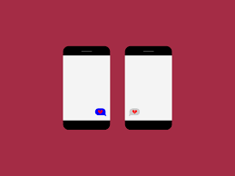
Breaking Up
If you’re ending your relationship, consider these tips:
If you don’t feel safe, do not break up in person. It may seem cruel to break up over the phone or by text but it may be the safest way.
If you break up in person, do it in a public place. Have friends or your parents wait nearby. Try to take a cell phone with you.
Do not try to explain your reasons for ending the relationship more than once. There is nothing you can say that will make your ex happy.
Let your friends and parents know you are ending your relationship, especially if you think your ex will come to your house or confront you when you are alone.
If your ex comes to your house when you are alone, do not go to the door.
Trust yourself. If you feel afraid, you probably have a good reason.
Ask for help. Chat with a peer advocate who is trained & ready to answer questions at www.loveisrespect.org
Notes:
Look for further information under Lesson 3: “What to do if I am in an Unhealthy/Abusive Relationship?”

Slide 17

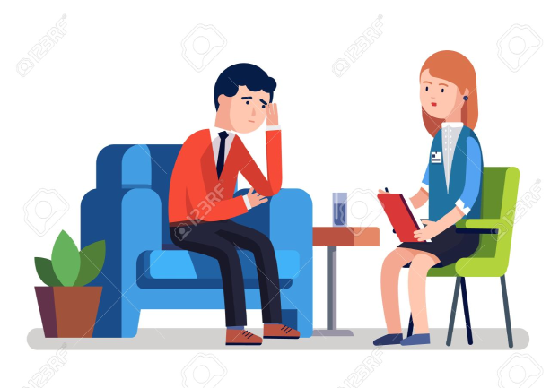
After Breaking Up
Talk to your friends and family.
Talk to a school counselor or teacher you trust. Together, you can alert security, adjust your class schedule or find other ways to help you feel safer if needed.
Avoid isolated areas at school and local hangouts.
Keep friends or family close when attending parties or events you think your ex might attend.
Save any threatening or harassing messages your ex sends. Set your profile to private on social networking sites
Memorize important numbers in case you don’t have access to your cell phone.
Notes:
Look for further information under Lesson 3: “What to do if I am in an Unhealthy/Abusive Relationship?”

Slide 18
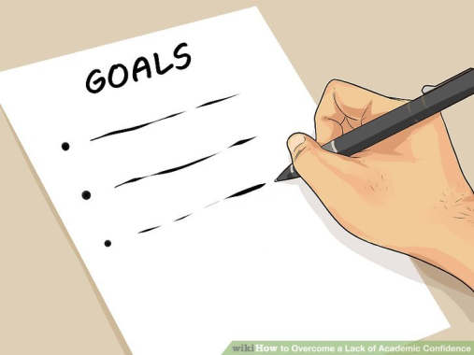
Can I stop being abusive?
What can you do?
Remember, violence is always a choice. There are no excuses and no one else to blame for being abusive.
Focus on how your abuse affects your partner and others. Fully accept how seriously you have hurt the people you care about.
Remember you are not alone. Your friends and family can support you through the difficult process of changing.
Get help from a school counselor and talk to them about mental health options.
Respect your partner’s right to be safe and healthy as you work toward change. Even if it means you can’t be together.
Because change is hard, there may be times when you may justify your actions or feel like giving up. Remember your original commitment to change and you’ll be more likely to succeed.
Notes:
Look for further information under Lesson 3: “What to do if I am in an Unhealthy/Abusive Relationship?”

